Slide 1

CoinMarketCap API Price Notifier
Real-time Cryptocurrency Price Tracking

Slide 2
Your best quote that reflects your approach… “It’s one small step for man, one giant leap for mankind.”
- Neil Armstrong

Slide 3
Introduction
What is CoinMarketCap?
This widely referenced market data website that normally provides comprehensive information on thousands of cryptocurrencies, e.g., cryptocurrency market cap ranking, charts, pricing, market capitalization on cryptocurrencies, trade volumes, etc.
What is an API?
Application Programming Interface; allows applications to communicate with one another.

Slide 4
The purpose of the project
Goal:
To develop a notifier that alerts users of real-time cryptocurrency price changes. The notifier
updates users on the top 5 performing and the bottom 5 non-performing crypto coins.
Benefits:
- Helps users to be updated with market trends.
- Make informed trading decisions.

Slide 5
Key Features
Real-Time Price Updates
Customizable Alerts via speech recognition alert
Supports Multiple Cryptocurrencies
Graphical representation of the data

Slide 6
Type of technologies used
Programming Language:
- python
Libraries:
- request
- json
- pyttsx3
- tabulate
- matplotlib
- Speech recognition
API:
- CoinMarketCap API

Slide 7
How the CoinMarketCap API Works
EndPoint:
/v1/cryptocurrency/listings/latest
Parameters:
Start, Limit< Convert(e.g. USD)
Response:
JSON format cryptocurrency data (name, symbol, price)

Slide 8
Project Architecture
Data Flow:
The program fetches data from CoinMarketCap API
Then processes data to check for price changes
If conditions are met then trigger notifications
Components:
API Handler
Data Processor
Notifier

Slide 9
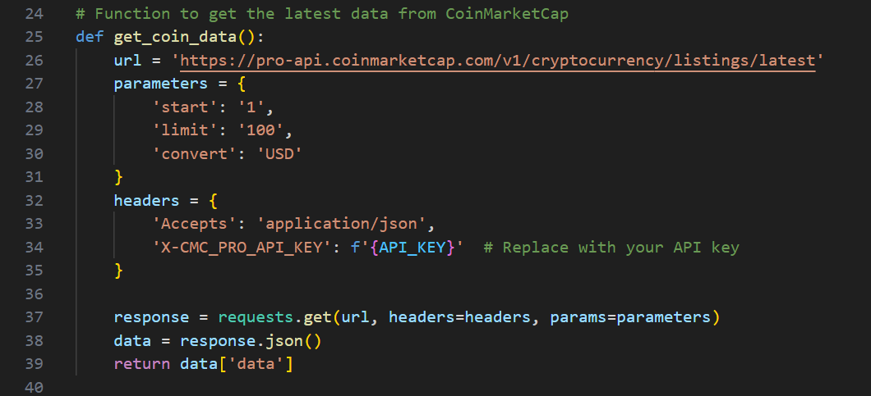
Code Overview
How the code works
Fetching Data:

Slide 10
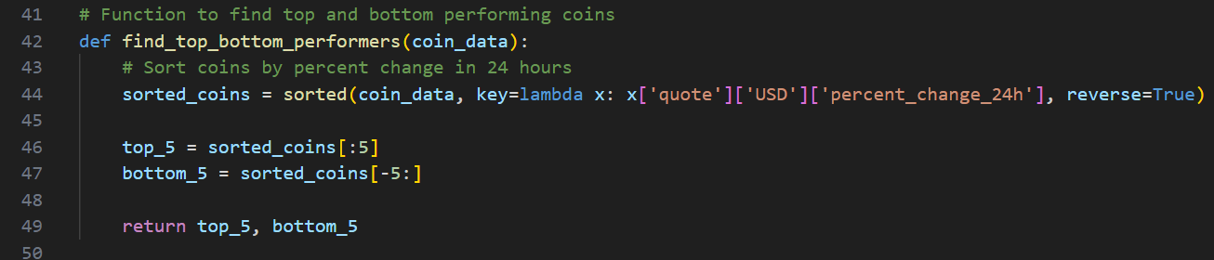
Code Overview
Setting up alerts on the top and bottom-performing coins

Slide 11
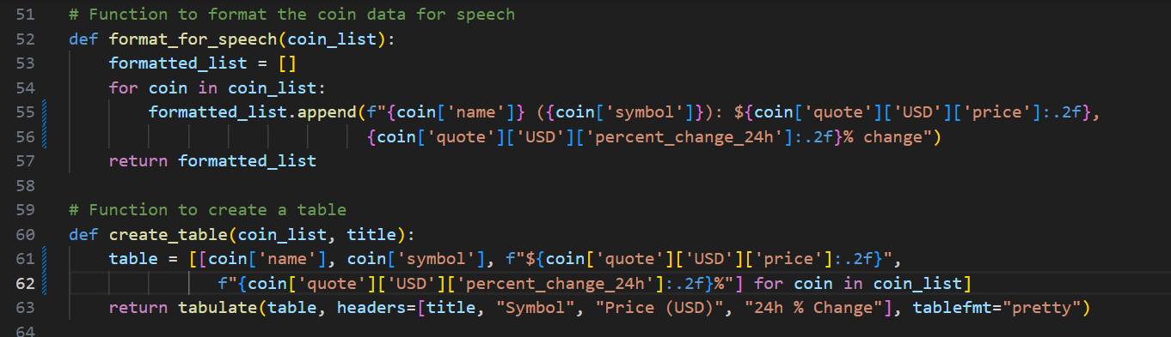
Code Overview
Format coin data for speech and place the data in a table

Slide 12
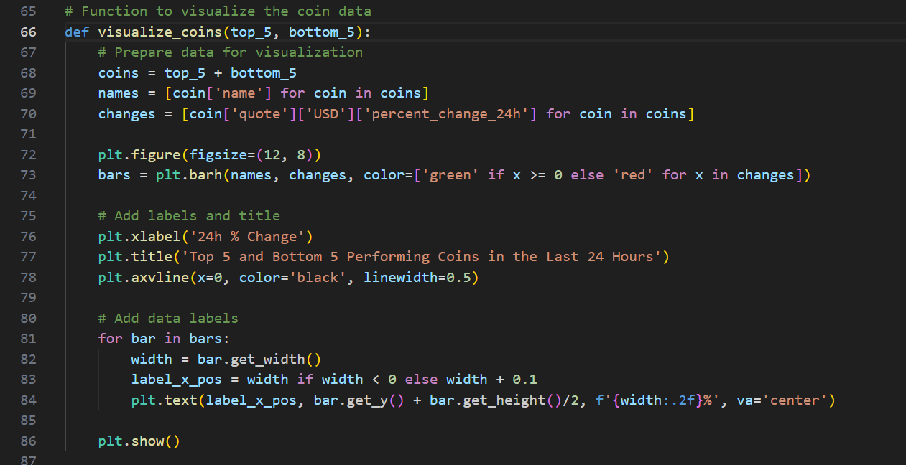
Code Overview
Visualize the data for easy interpretation of changes

Slide 13
Future Enhancements
Additional futures
- Email notifications
- SMS alerts
- Add more features in analysing the data.

Slide 14
Conclusion
Summary:
The coinmarketcap api helps the users to get informed and make timely decisions
Real-time price update regarding performing coins and non-performing coins.
Q & A

Slide 15
THANK YOU

